Slide 1
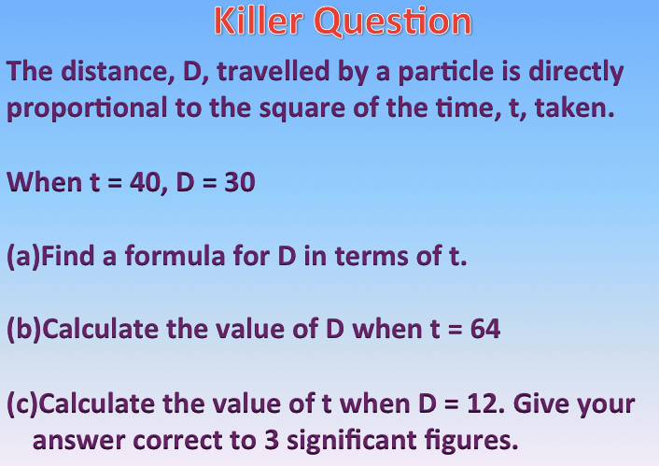

Direct/Inverse Proportion
I will be able to solve directly proportional problems
Keywords: Direct, Inversely, Proportion, Constant, Rate of Change
I will be able to understand what it means for something to be D.P.
I will be able to find the value of k, rate of change.
I will be able to solve problems which are linked to direct proportion.
Last Lesson
This Lesson
Direct Proportion
Next Lesson

Slide 2
Direct Proportion
y α x
General Equation: y = kx
Direct Proportion: If one value increases,
so does the other.

Slide 3
Inverse Proportion
y α 1/x
General Equation: y = k/x
Inverse Proportion: If one value increases,
the other value decreases.

Slide 4
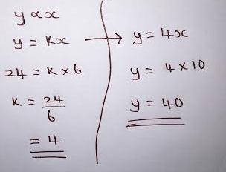
Direct Proportion WAGOLL
If y varies directly with x and when y = 24 , x = 6 . Find the value y when x = 10.

Slide 5
Independent Task: Direct Proportion
If y varies directly with x and when y = 30 , x = 5 . Find the value y when x = 7.

Slide 6
Independent Task: Direct Proportion
If y varies directly with the square of x and when y = 100 and x = 5. Find the value x when y = 64.
Notes:
6

Slide 7



MG = World Class
O = Outstanding
G = Good
RI = Requires Improvement
Self Assessment!
WWW: WHAT WENT WELL???
EBI: EVEN BETTER IF???
How well do you understand the topic?
.
I don’t understand
I nearly understand
I fully understand

Slide 8
Direct Proportion
y is directly proportional to x. If y = 55 when x = 5. Find the value of y when x = 7.
y is directly proportional to x. If y = 60 when x = 120. Find the value of y when x = 50.
y is directly proportional to x². If y = 100 when x = 2. Find the value of y when x = 3.
D is proportional to S². D = 900 when S = 20. Calculate the value of D when S = 25.
M is directly proportional to L³. When L = 2, M = 160. Find the value of M when L = 3.
n is proportional to √m. n is 14 when m = 49. Find the value of n when m = 100.
Challenge Question
d is directly proportional to the square of t. d = 80 when t = 4.
(a) Express d in terms of t.
Work out the value of d when t = 7.

Slide 9
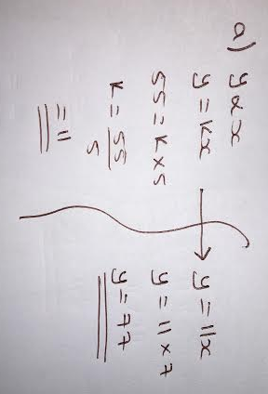
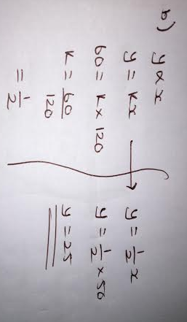
Direct Proportion

Slide 10
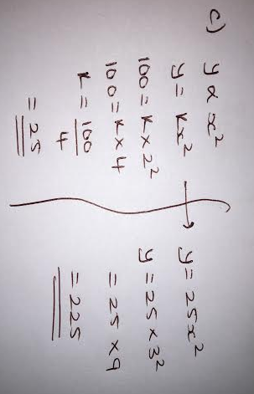
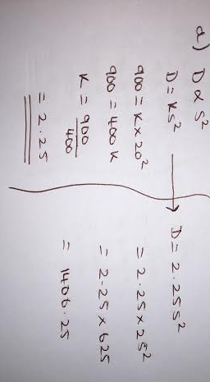
Direct Proportion

Slide 11
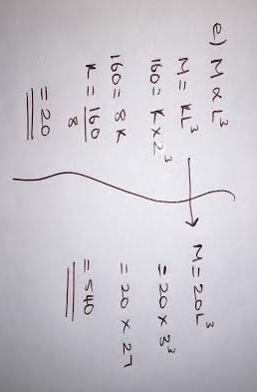
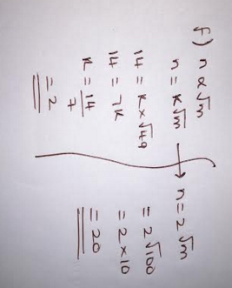
Direct Proportion

Slide 12
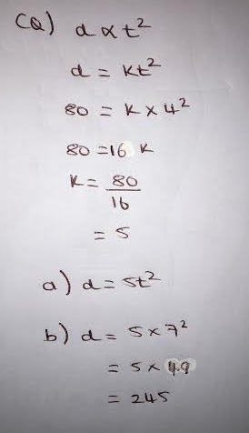
Direct Proportion

Slide 13
MG = World Class
O = Outstanding
G = Good
RI = Requires Improvement
Self Assessment!
WWW: WHAT WENT WELL???
EBI: EVEN BETTER IF???
How well do you understand the topic?
.
I don’t understand
I nearly understand
I fully understand

Slide 14
Worded Exam Problems
The weight of a piece of wire is directly proportional to its length. A piece of wire is 25 cm long and has a weight of 6 grams. Another piece of the same wire is 30 cm long.
a) Calculate the weight of the 30 cm piece of wire.
2) In a spring, the tension (T newtons) is directly proportional to its extension (x cm).When the tension is 150 newtons, the extension is 6 cm.
Find a formula for T in terms of x.
Calculate the tension, in newtons, when the extension is 15 cm.
Calculate the extension, in cm, when the tension is 600 newtons.
3) A ball falls vertically after being dropped. The ball falls a distance d metres in a time of t seconds. d is directly proportional to the square of t.
The ball falls 20 metres in a time of 2 seconds.
Find a formula for d in terms of t.
Calculate the distance the ball falls in 3 seconds.
Calculate the time the ball takes to fall 605 m.

Slide 15
Worded Exam Problems
The weight of a piece of wire is directly proportional to its length. A piece of wire is 25 cm long and has a weight of 6 grams. Another piece of the same wire is 30 cm long.
a) Calculate the weight of the 30 cm piece of wire.
2) In a spring, the tension (T newtons) is directly proportional to its extension (x cm).When the tension is 150 newtons, the extension is 6 cm.
Find a formula for T in terms of x.
Calculate the tension, in newtons, when the extension is 15 cm.
Calculate the extension, in cm, when the tension is 600 newtons.
3) A ball falls vertically after being dropped. The ball falls a distance d metres in a time of t seconds. d is directly proportional to the square of t.
The ball falls 20 metres in a time of 2 seconds.
Find a formula for d in terms of t.
Calculate the distance the ball falls in 3 seconds.
Calculate the time the ball takes to fall 605 m.

Slide 16
MG = World Class
O = Outstanding
G = Good
RI = Requires Improvement
Self Assessment!
WWW: WHAT WENT WELL???
EBI: EVEN BETTER IF???
How well do you understand the topic?
.
I don’t understand
I nearly understand
I fully understand

Slide 17
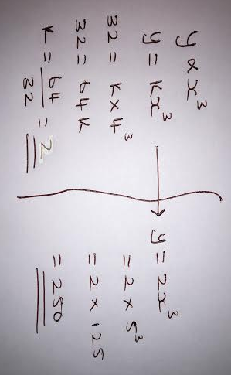
Spot the Mistake
If y varies directly with x³ and when y = 32 , x = 4 . Find the value y when x = 5 .

Slide 18
Killer Question
The distance, D, travelled by a particle is directly proportional to the square of the time, t, taken.
When t = 40, D = 30
Find a formula for D in terms of t.
Calculate the value of D when t = 64
Calculate the value of t when D = 12. Give your answer correct to 3 significant figures.
Notes:
18

Slide 19
Self Assessment!
MG = World Class
O = Outstanding
G = Good
RI = Requires Improvement
I don’t understand
I nearly understand
I fully understand
WWW – What Went Well?
I can for an equation when two variables are directly proportional.
I can find missing values when the variables vary linearly.
I can find missing values with squares, cubes and roots.
EBI – Even Better If?
I combine find missing values when variables vary linearly.
I can find missing values with squares, cubes and roots.
I can solve inverse proportion problems.

Slide 20
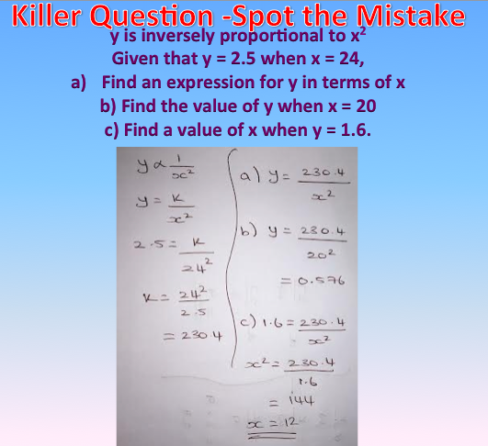
Inverse Proportion
I will be able to solve problems when two variable are inversely proportional.
Keywords: Direct, Inversely, Proportion, Constant, Rate of Change
I will be able to understand what it means for something to be I.P.
I will be able to find the value of k, rate of change.
I will be able to solve problems which are linked to Inverse proportion.
Last Lesson
This Lesson
Inverse Proportion
Next Lesson

Slide 21
Direct Proportion
y α x
General Equation: y = kx
Direct Proportion: If one value increases,
so does the other.

Slide 22
Inverse Proportion
y α 1/x
General Equation: y = k/x
Inverse Proportion: If one value increases,
the other value decreases.

Slide 23
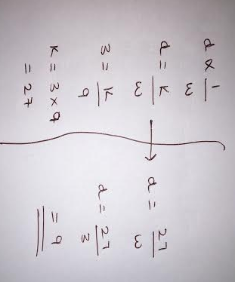
WAGOLL: Inverse Proportion
If d varies inversely with w and when d = 3 and w = 9 . Find the value d when w = 3.
Notes:
23

Slide 24
Independent Task: Inverse Proportion
If d varies inversely with w and when d = 6 and w = 18 . Find the value d when w = 3.
Notes:
24

Slide 25
MG = World Class
O = Outstanding
G = Good
RI = Requires Improvement
Self Assessment!
WWW: WHAT WENT WELL???
EBI: EVEN BETTER IF???
How well do you understand the topic?
.
I don’t understand
I nearly understand
I fully understand

Slide 26
Inverse Proportion
p is inversely proportional to m. p = 48 when m = 9. Calculate the value of p when m = 12.
r is inversely proportional to t. r = 12 when t = 0.2. Calculate the value of r when t = 4.
P is inversely proportional to d². P = 10 000 when d = 0.4. Find the value of P when d = 0.8.
y is inversely proportional to x². Given that y = 2.5 when x = 24,find the value of y when x = 20.
y is inversely proportional to x. If y = 50 when x = 4. Find the value of y when x = 16.
Challenge Question
q is inversely proportional to the square of t.
When t = 4, q = 8.5
(a) Find a formula for q in terms of t.
(b) Calculate the value of q when t = 5.

Slide 27
MG = World Class
O = Outstanding
G = Good
RI = Requires Improvement
Self Assessment!
WWW: WHAT WENT WELL???
EBI: EVEN BETTER IF???
How well do you understand the topic?
.
I don’t understand
I nearly understand
I fully understand

Slide 28
Worded Exam Problems
1) The time, T seconds, it takes a water heater to boil a constant mass of water is inversely proportional to the power, P watts, of the water heater. When P = 1400, T = 360.
Find the value of T when P = 900
2) The shutter speed, S, of a camera varies inversely as the square of the aperture setting, f. When f = 8, S = 125
Find a formula for S in terms of f.
Hence, or otherwise, calculate the value of S when f = 4.
3) The force, F, between two magnets is inversely proportional to the square of the distance, x, between them. When x = 3, F = 4.
Calculate F when x = 2.
Calculate x when F = 64.
Notes:
28

Slide 29
MG = World Class
O = Outstanding
G = Good
RI = Requires Improvement
Self Assessment!
WWW: WHAT WENT WELL???
EBI: EVEN BETTER IF???
How well do you understand the topic?
.
I don’t understand
I nearly understand
I fully understand

Slide 30
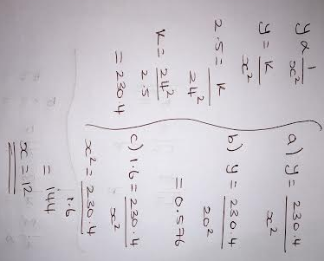
Spot the Mistake
y is inversely proportional to x²
Given that y = 2.5 when x = 24,
Find an expression for y in terms of x
b) Find the value of y when x = 20
c) Find a value of x when y = 1.6.

Slide 31
Killer Question
In an experiment, measurements g and h were taken.
h | 2 | 5 | 7
g | 24 | 375 | 1029
Which of these relationships fits the results.
g∝h g∝h² g∝h³ g∝√h

Slide 32
Killer Question
In an experiment, measurements a and b were taken.
a | 45 | 125 | 320
g | 3 | 5 | 8
Which of these relationships fits the results.
a∝b a∝b² a∝b³ a∝√b

Slide 33
Killer Question
a is directly proportional to the square root of c. w inversely proportional to a².
When c = 49, a = 35. When a = 2, w = 16 Find the value of w when c = 4.

Slide 34
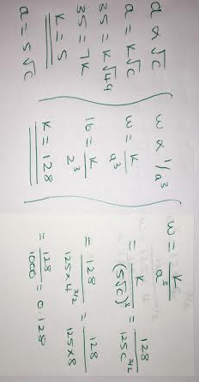
Killer Question
a is directly proportional to the square root of c. w inversely proportional to a².
When c = 49, a = 35. When a = 2, w = 16 Find the value of w when c = 4.

Slide 35
Self Assessment!
MG = World Class
O = Outstanding
G = Good
RI = Requires Improvement
I don’t understand
I nearly understand
I fully understand
WWW – What Went Well?
I can for an equation when two variables are inversely proportional.
I can find missing values when the variables vary linearly.
I can find missing values with squares, cubes and roots.
EBI – Even Better If?
I combine find missing values when variables vary linearly.
I can find missing values with squares, cubes and roots.
I can solve proportion exam problems.

